Slide 1
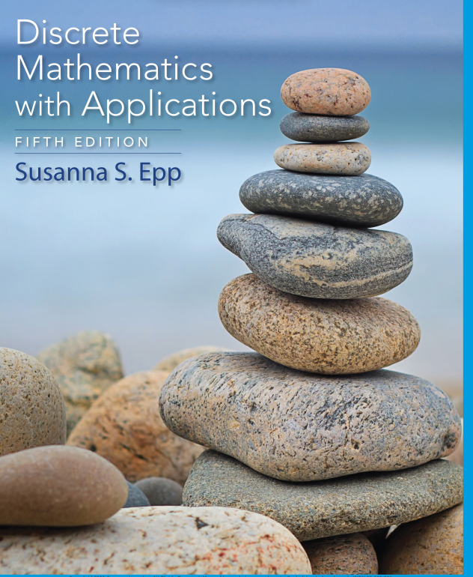
Chapter 1
Database Systems

Slide 2

Faculty of Computer Science
UFCFFS-30-1– Foundations of Computing: Analysis of Algorithms & Algorithm Complexity & Big-O notations
Instructor: Duc Minh Vu
3/3/2024
Data Structures and Algorithms in Python
2

Slide 3
Learning Objectives
Real-Valued Functions of a Real Variable and Their Graphs
Big-O, Big-Omega, and Big-Theta Notations
Analysis of Algorithm Efficiency I
Exponential and Logarithmic Functions: Graphs and Orders
Analysis of Algorithm Efficiency II

Slide 4
Reading
Chapter 11 - Discrete Mathematics with Applications 5th Edition (Susanna’s Book)
Chapter 3 – Discrete Mathematics and Its Applications 7th Edition (Kenneth Rosen’s book)

Slide 5
Application: Analysis of Algorithm Efficiency I

Slide 6
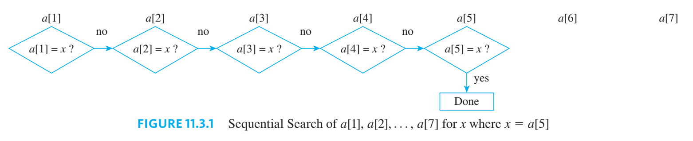
11.3 Application: Analysis of Algorithm Efficiency I
The Sequential Search Algorithm
Best-, worst-, and Average-Case Orders for Sequential Search
O(1), O(n) and O(n)

Slide 7
Measuring the Efficiency of an Algorithm
Two aspects of algorithm efficiency are important: time required to execute the algorithm and memory space needed when it is run.
The analysis of an algorithm for time efficiency count the number of elementary operations that must be performed when the algorithm is executed with an input of size n.
Elementary operations: addition, subtraction, multiplication, division, and comparisons

Slide 8
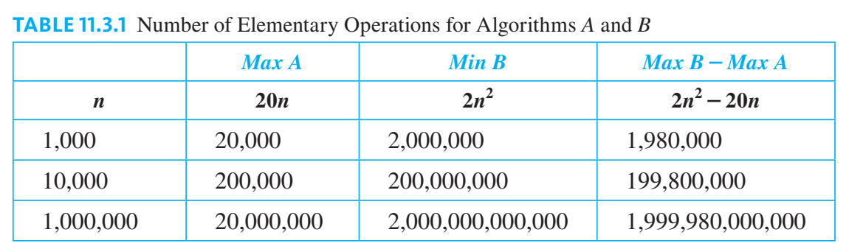

Slide 9
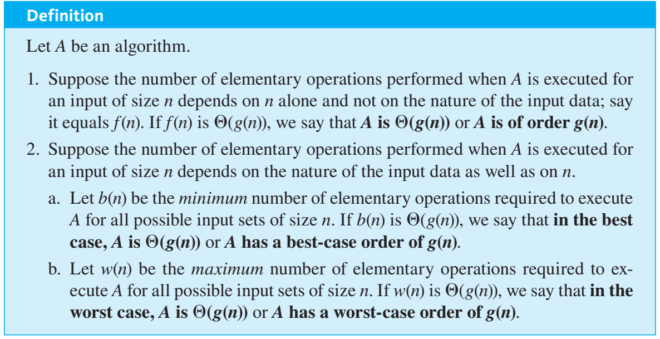

Slide 10
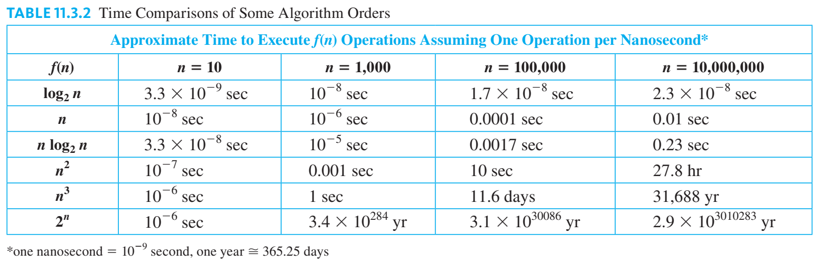

Slide 11
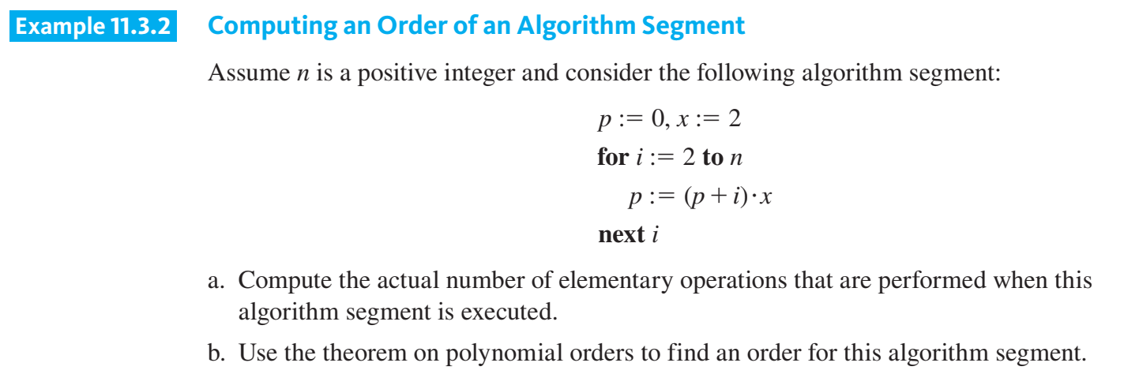

Slide 12
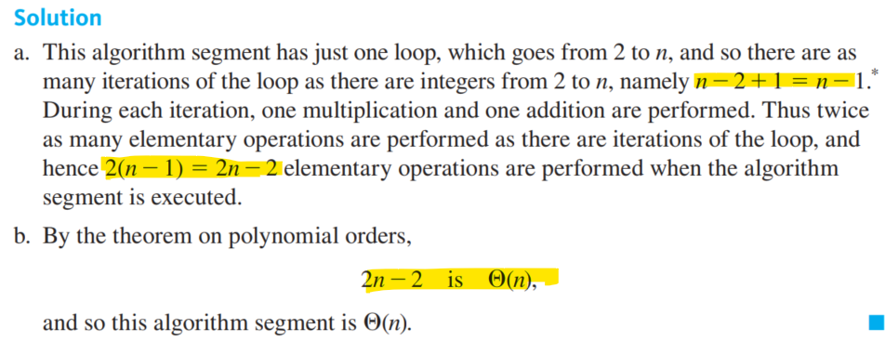

Slide 13
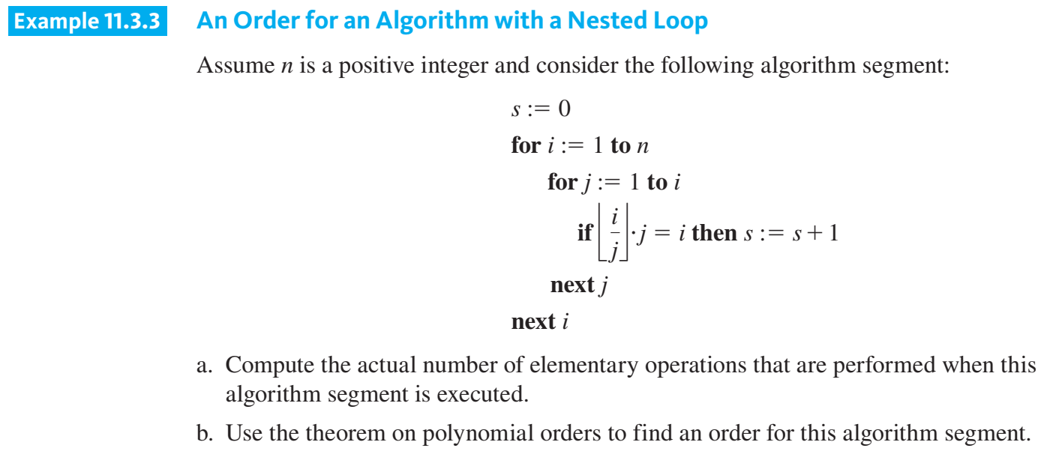

Slide 14
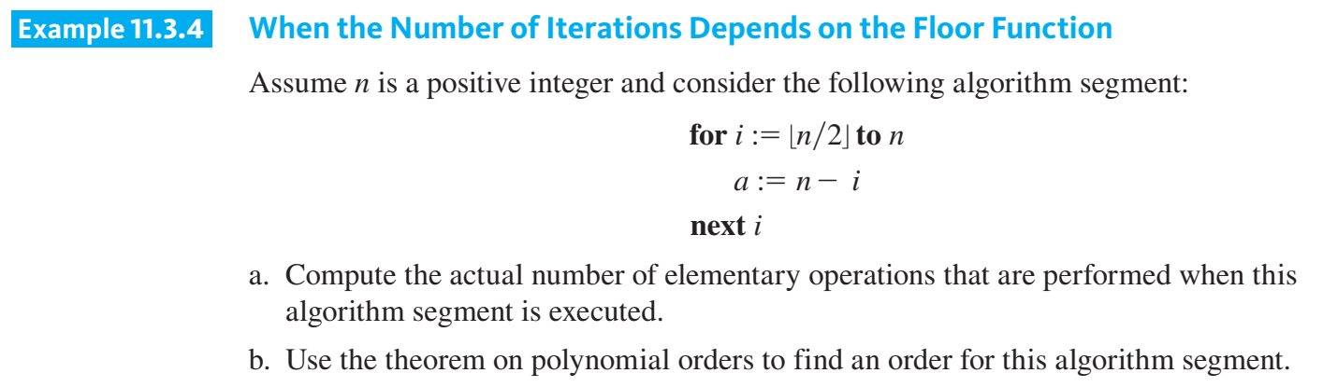

Slide 15
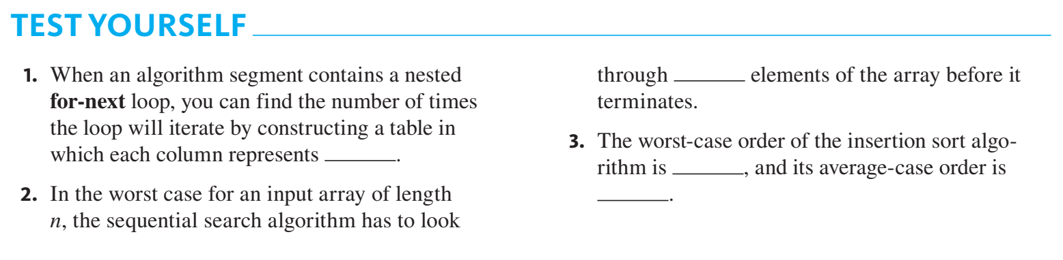

Slide 16
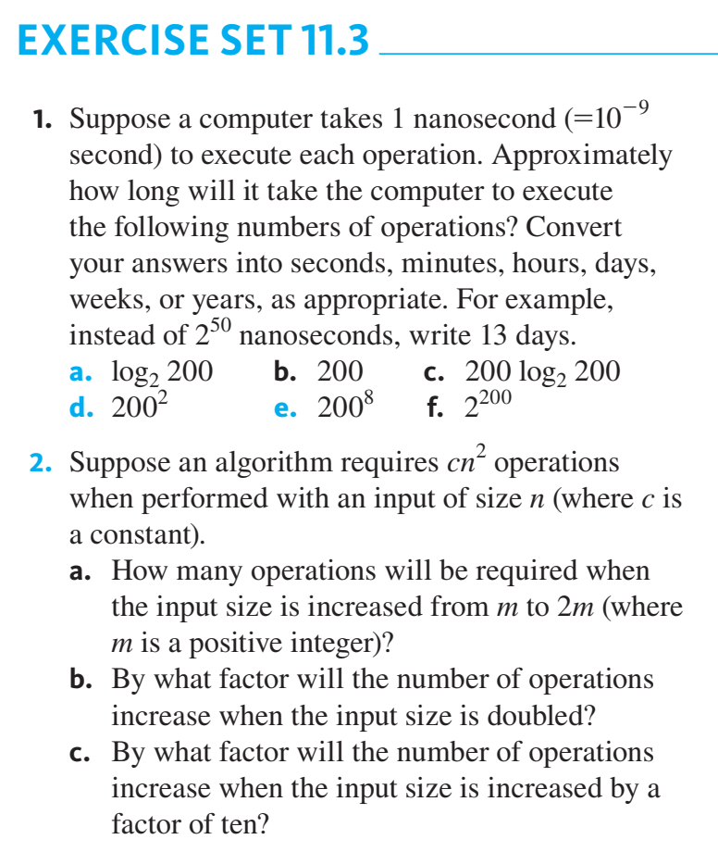

Slide 17
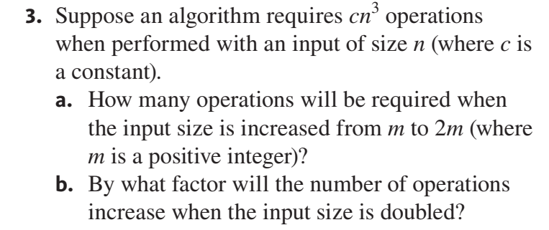
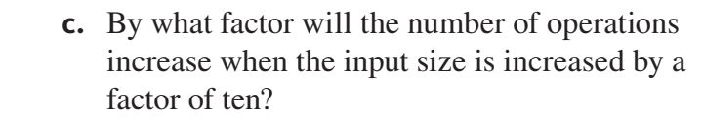

Slide 18
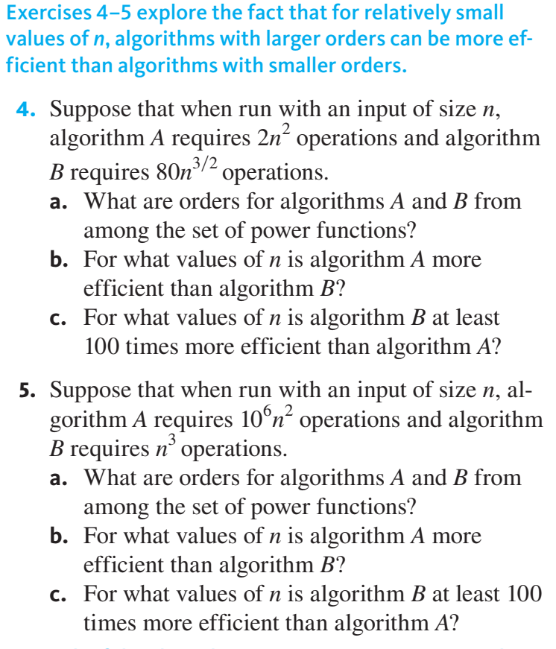

Slide 19
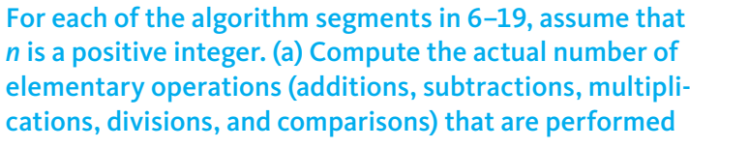
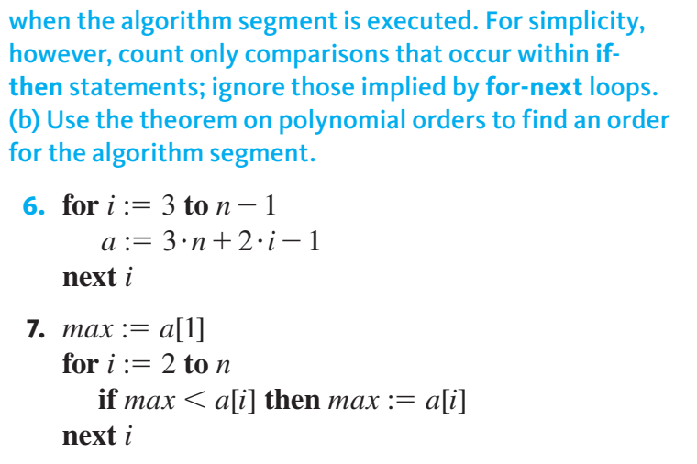

Slide 20
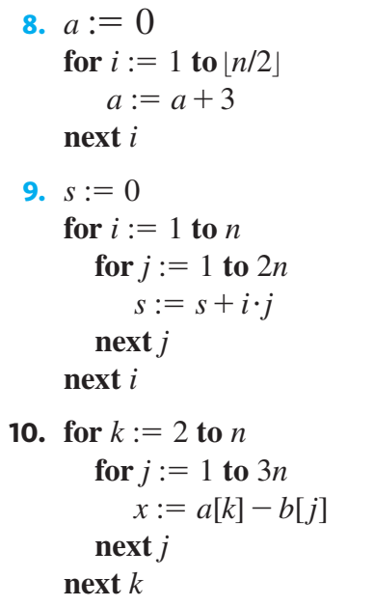
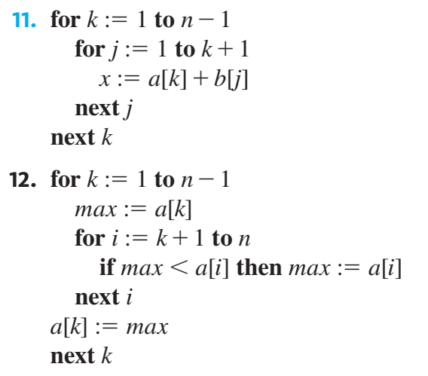

Slide 21
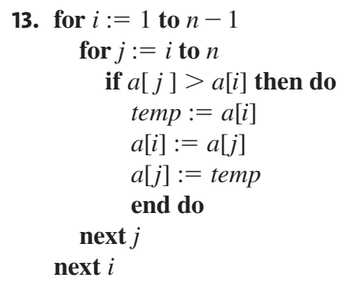
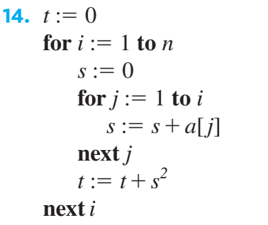
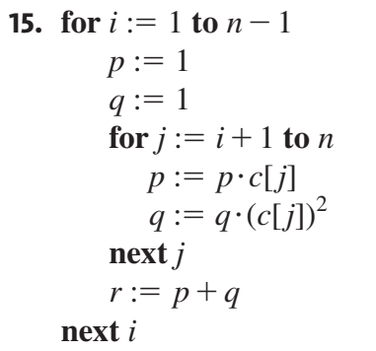

Slide 22
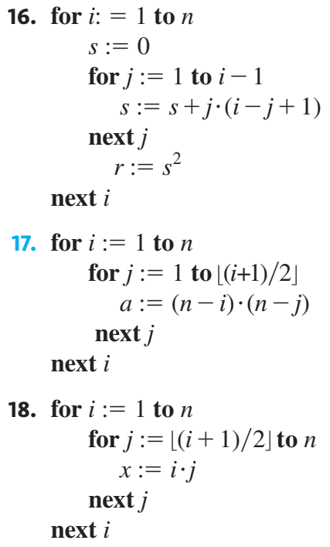
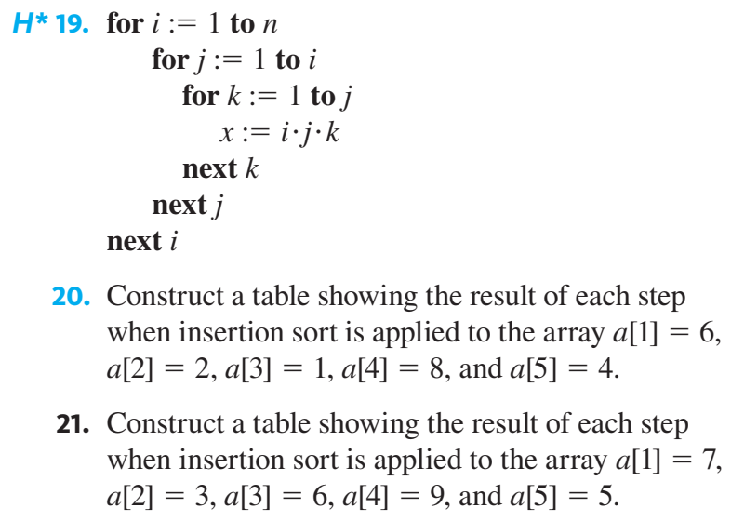

Slide 23
Exponential and Logarithmic Functions: Graphs and Orders

Slide 24
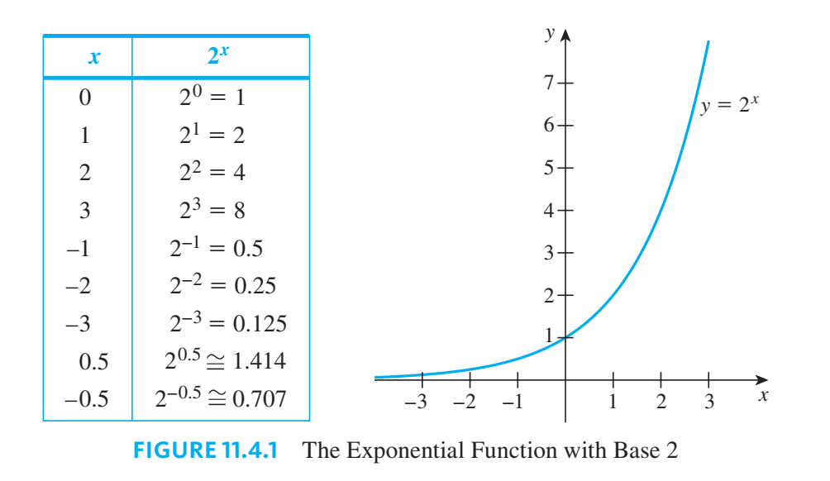

Slide 25
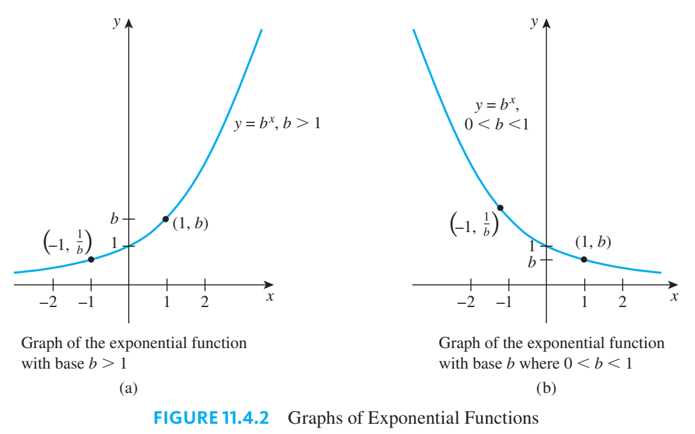

Slide 26
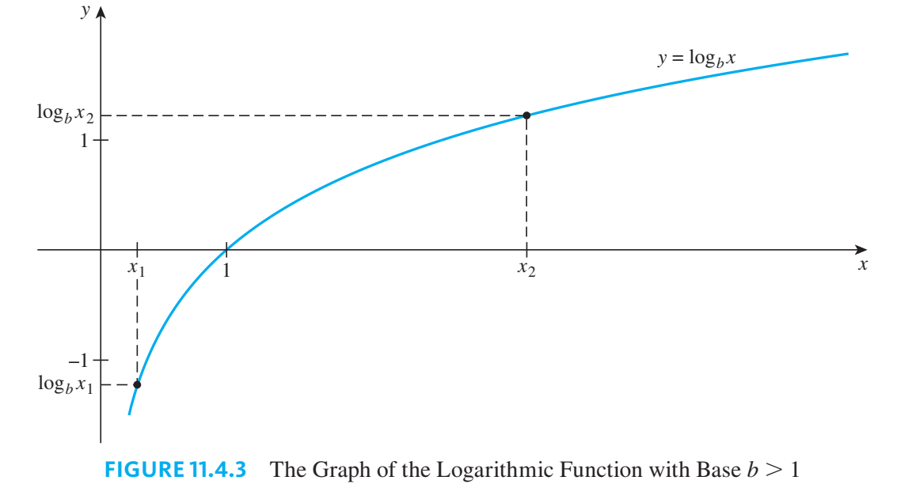

Slide 27
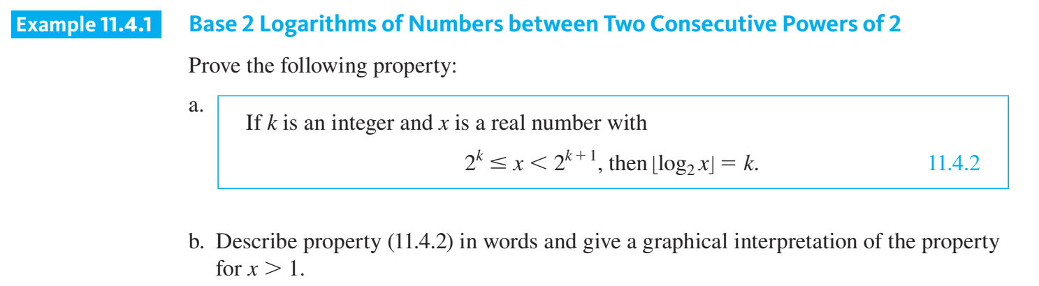

Slide 28
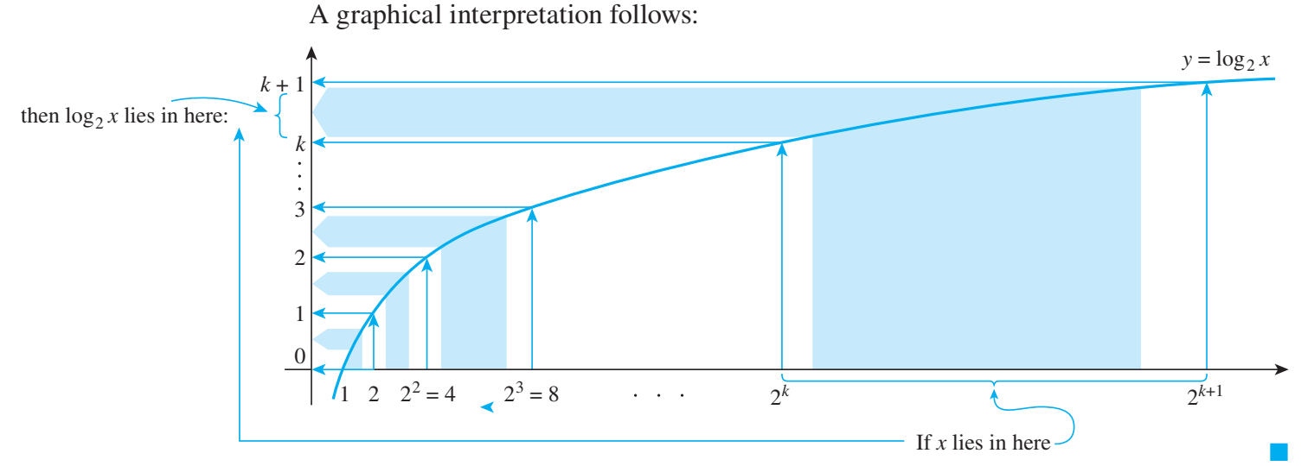

Slide 29
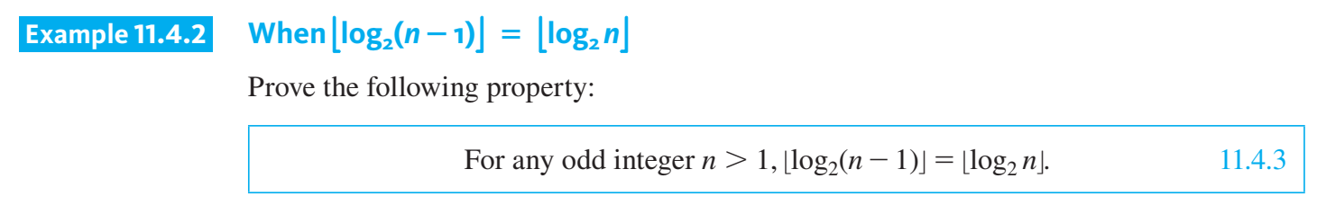

Slide 30
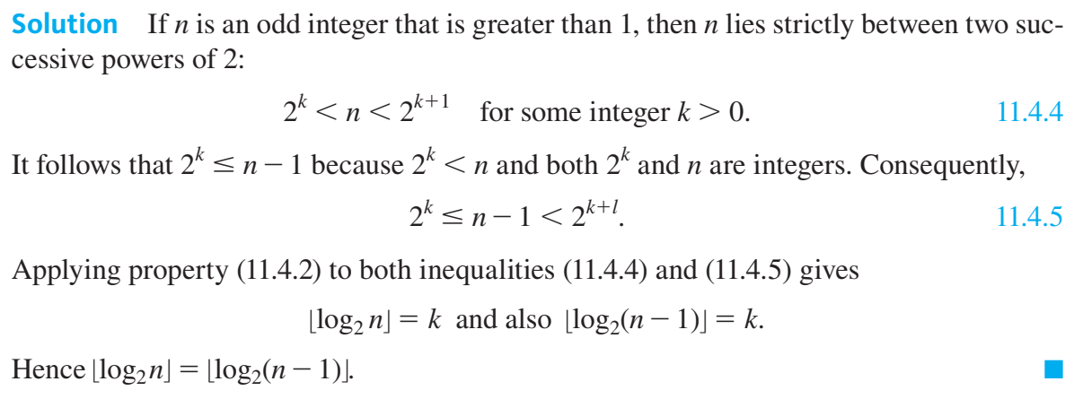

Slide 31

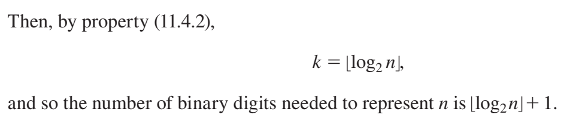

Slide 32
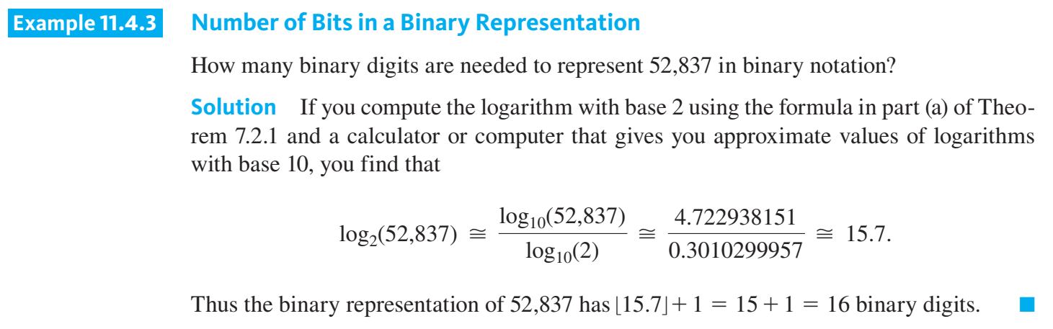

Slide 33
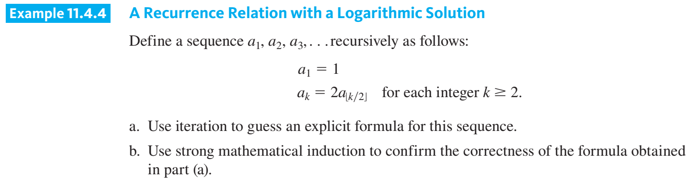

Slide 34
Exponential and Logarithmic Orders

Slide 35
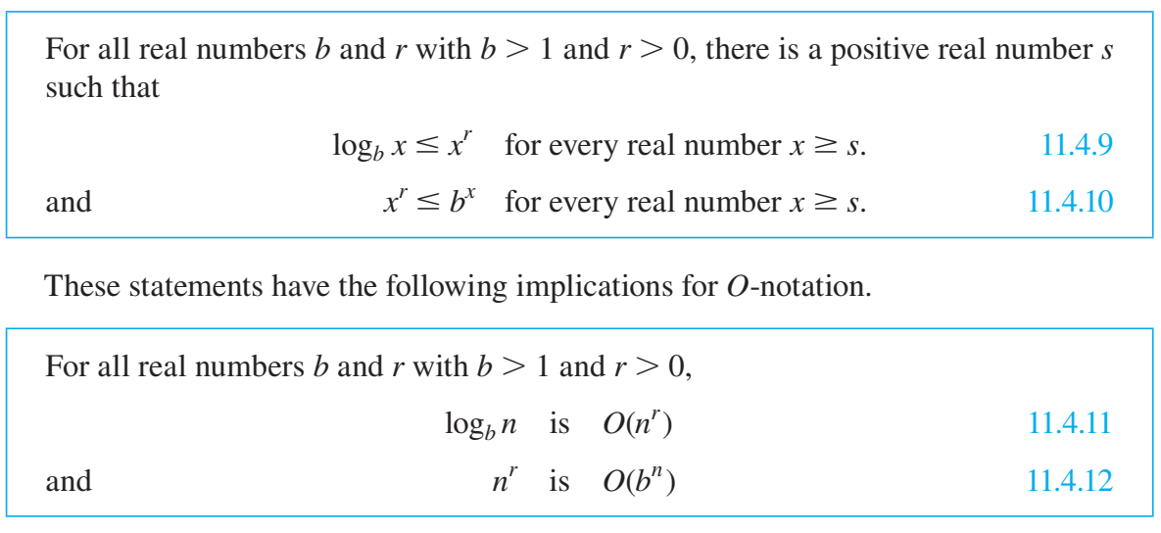

Slide 36
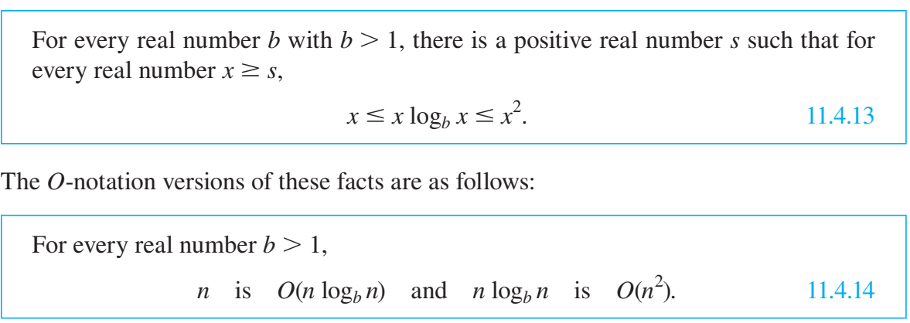

Slide 37
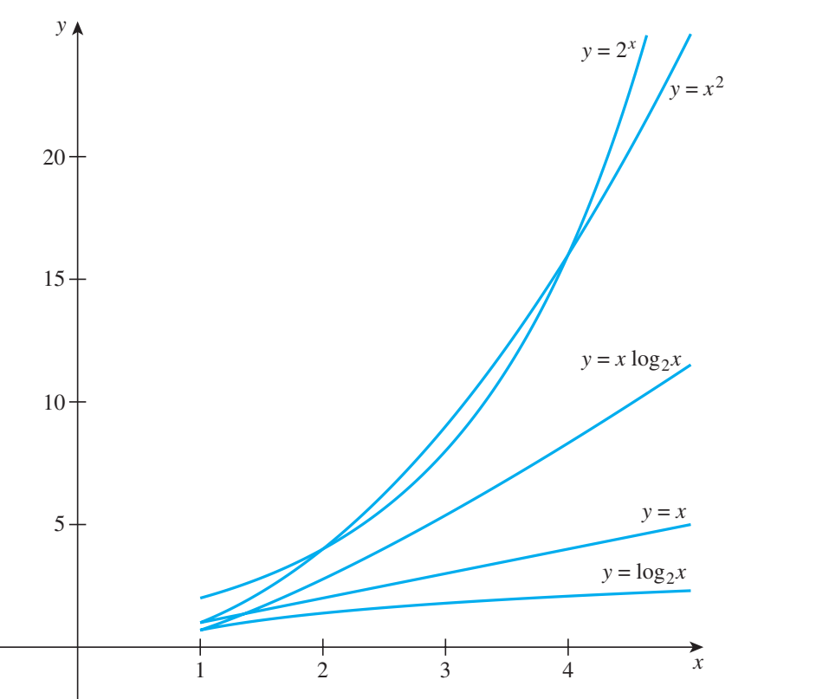

Slide 38
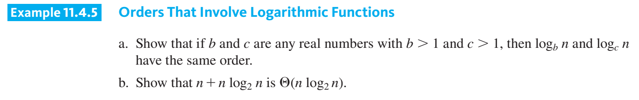

Slide 39
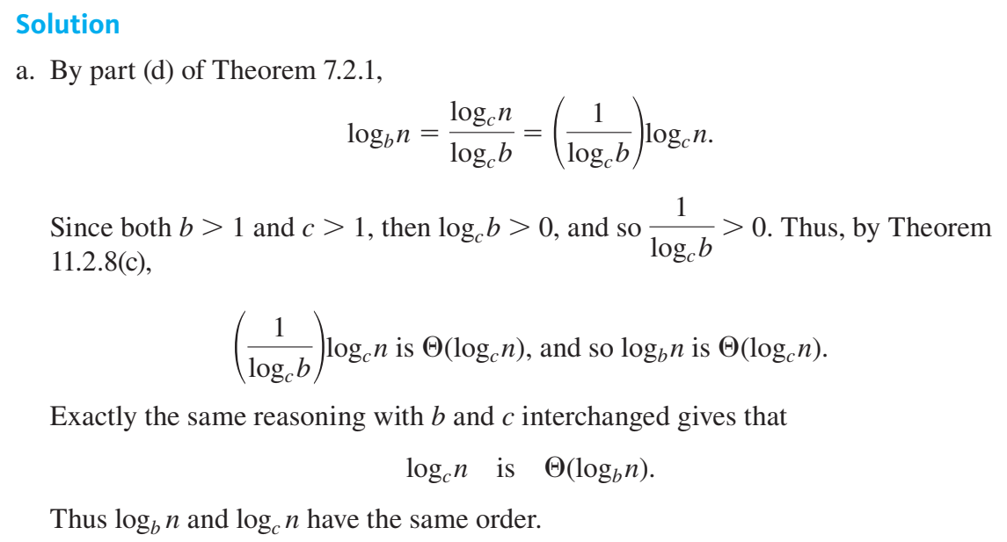

Slide 40
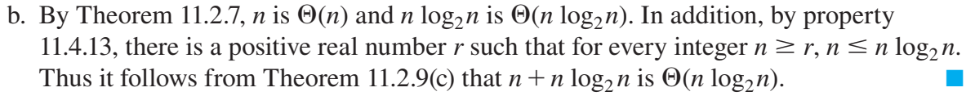

Slide 41
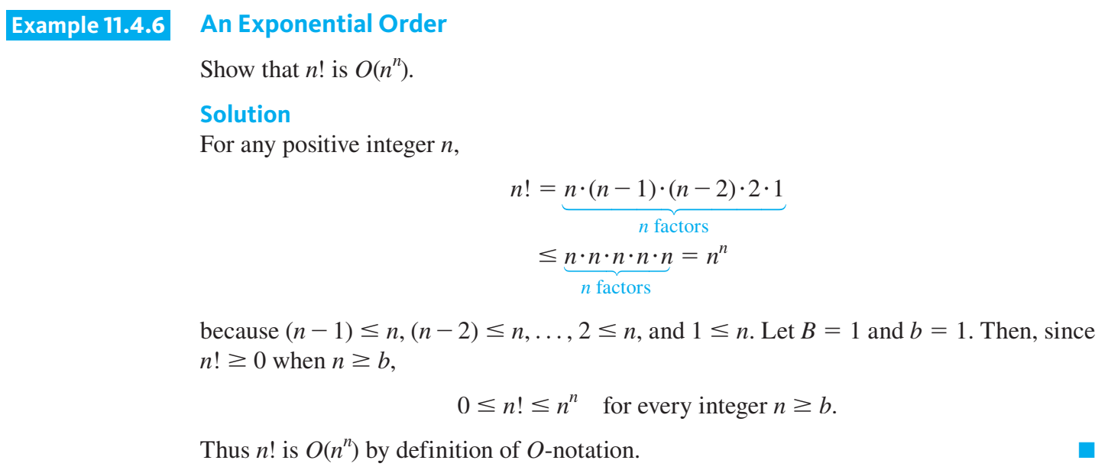

Slide 42
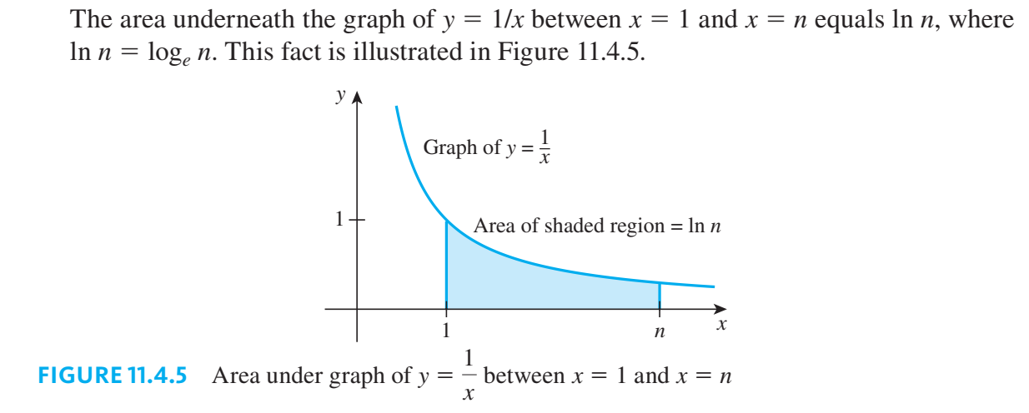

Slide 43
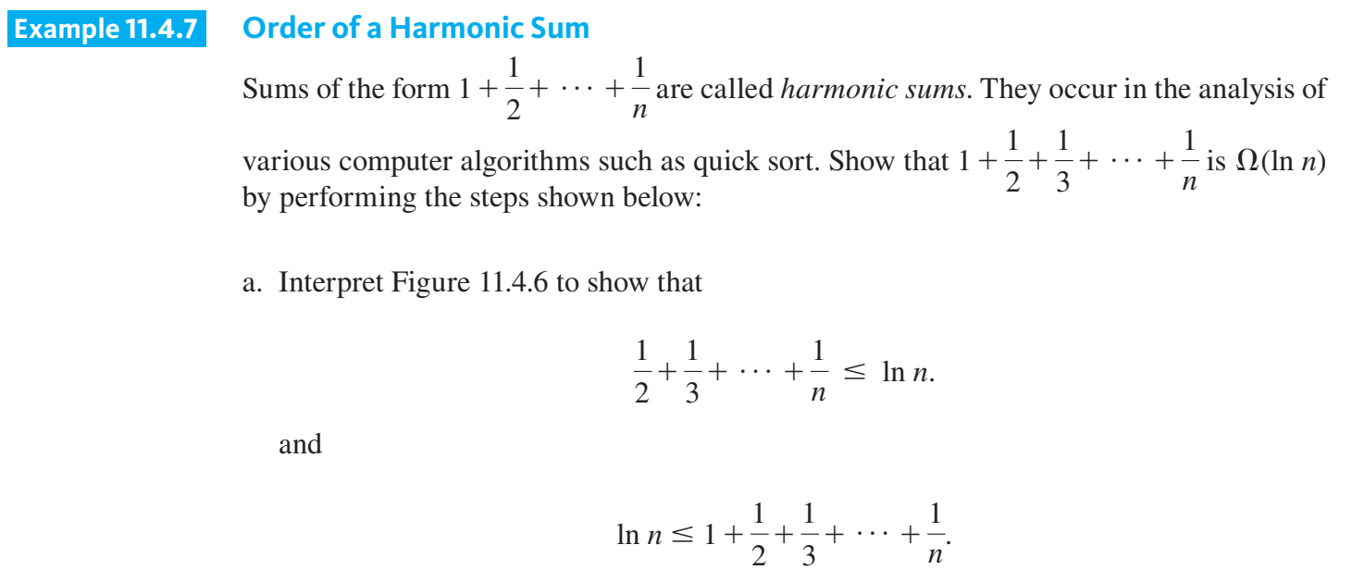

Slide 44
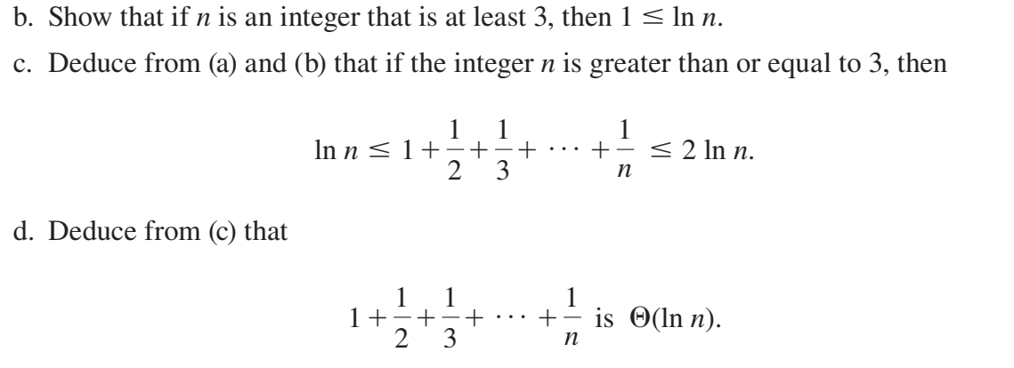

Slide 45
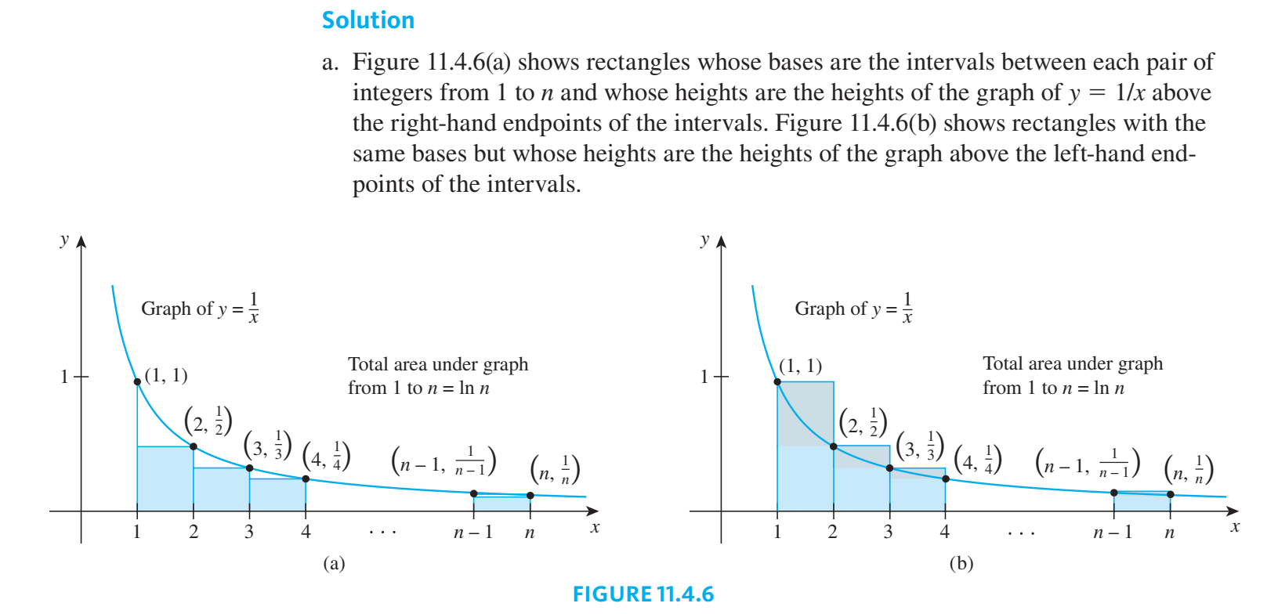

Slide 46
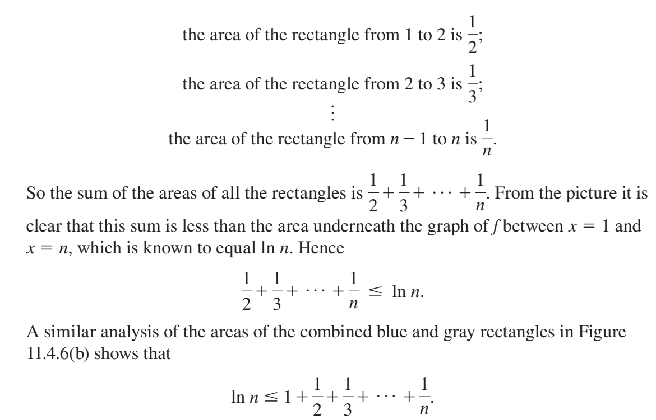

Slide 47
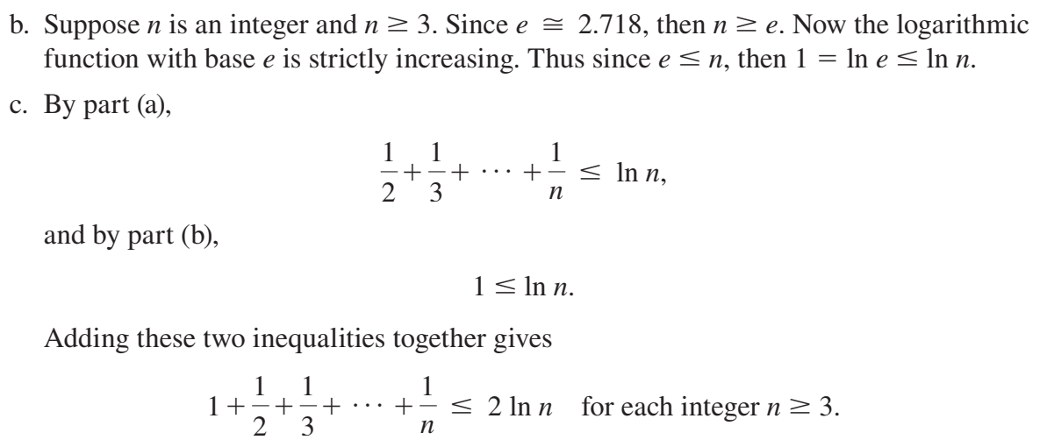

Slide 48
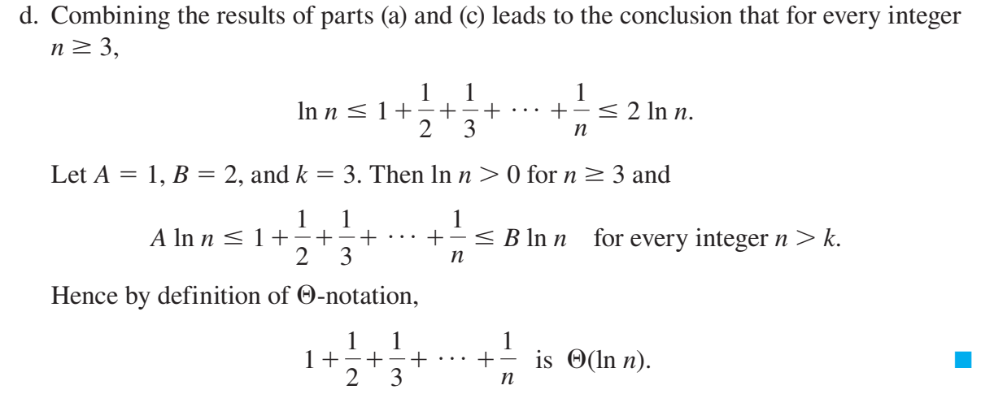

Slide 49
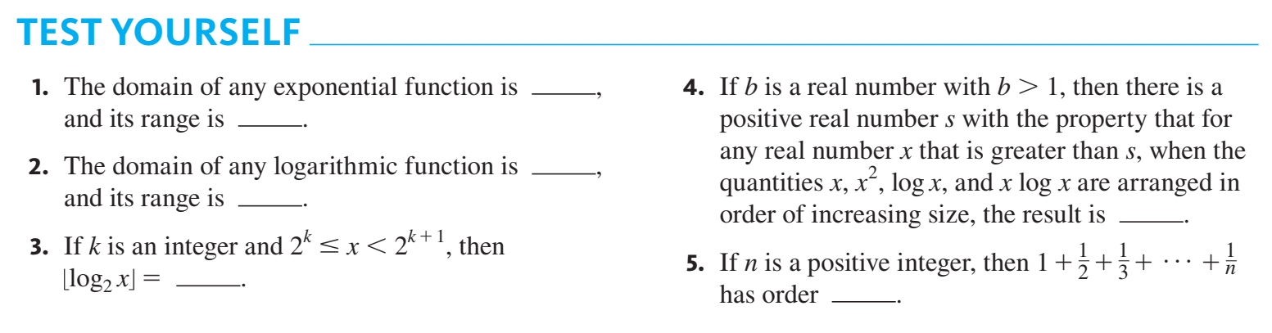

Slide 50
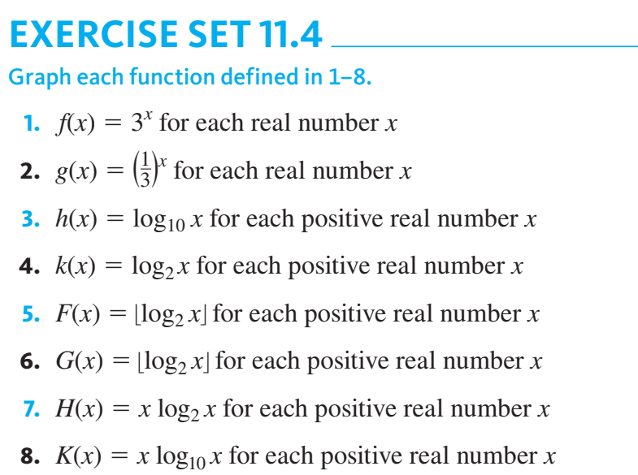

Slide 51
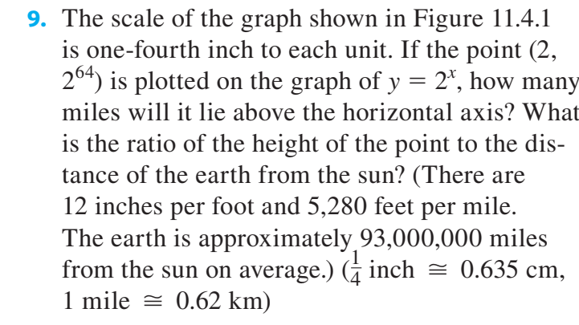

Slide 52


Slide 53


Slide 54


Slide 55


Slide 56


Slide 57


Slide 58


Slide 59
Application: Analysis of Algorithm Efficiency II

Slide 60

Binary Search

Slide 61


Slide 62


Slide 63


Slide 64


Slide 65


Slide 66


Slide 67


Slide 68


Slide 69


Slide 70


Slide 71
Questions?

